Slide 1
Process Management
Contents: What is Process, process elements, process control block, process creation and termination, Control tables, Threads

Slide 2
Requirement of OS
Fundamental Task: Process Management
The Operating System must
  Interleave the execution of multiple processes
  Allocate resources to processes, and protect the resources of each process from other processes,
  Enable processes to share and exchange information,
  Enable synchronization among processes.

Slide 3
What is Process?
A program in execution
An instance of a program running on a computer
The entity that can be assigned to and executed on a processor
A unit of activity characterized by the execution of a sequence of instructions, a current state, and an associated set of system instructions

Slide 4
Process Elements
  A process is comprised of:
    Program code (possibly shared)
    A set of data
    A number of attributes describing the state of the process

Slide 5
Process Elements
  While the process is running it has a number of elements including
    Identifier
    State
    Priority
    Program counter
    Memory pointers
    Context data
    I/O status information
    Accounting information

Slide 6
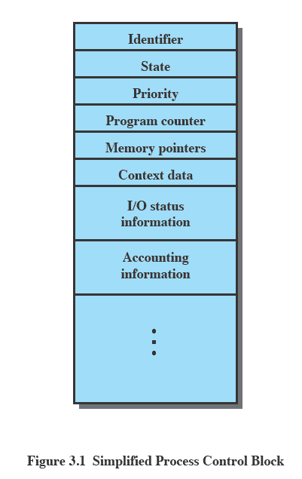
Process Control Block
  Contains the process elements
  Created and manage by the operating system
  Allows support for multiple processes

Slide 7
Trace of a Process
  The behavior of an individual process is shown by listing the sequence of instructions that are executed. This list is called a Trace
  Dispatcher is a small program which switches the processor from one process to another

Slide 8
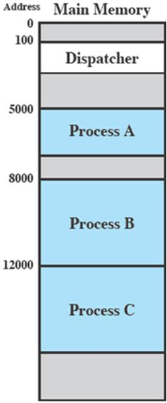
Process Execution
  Consider three processes being executed
  All are in memory (plus the dispatcher)
  Lets ignore virtual memory for this.

Slide 9
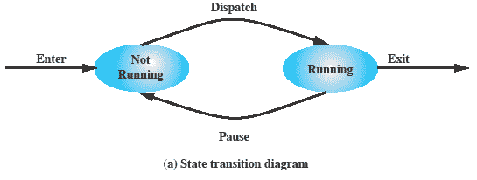
Two State Process Model
  Process may be in one of two states
    Running
    Not-running

Slide 10
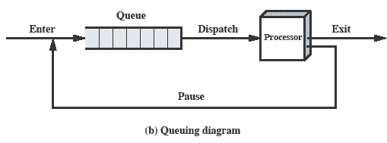
Queue
  Processes moved by the dispatcher of the OS to the CPU then back to the queue until the task is competed

Slide 11
Process Creation
  The OS builds a data structure to manage the process
  Traditionally, the OS created all processes, But it can be useful to let a running process create another
  This action is called process spawning
    Parent Process is the original, creating, process
    Child Process is the new process
Notes:
main()
{
printf( “Hello”); // Wil be executed by Parent only
fork(); // parent process will create child process
prinf(“Welcome”); // Will be executed by Parent and Child 2 times printed
}

Slide 12
Process Termination
There must be some way that a process can indicate completion.
This indication may be:
    A HALT instruction generating an interrupt alert to the OS.
    A user action (e.g. log off, quitting an application)
    A fault or error
    Parent process terminating

Slide 13
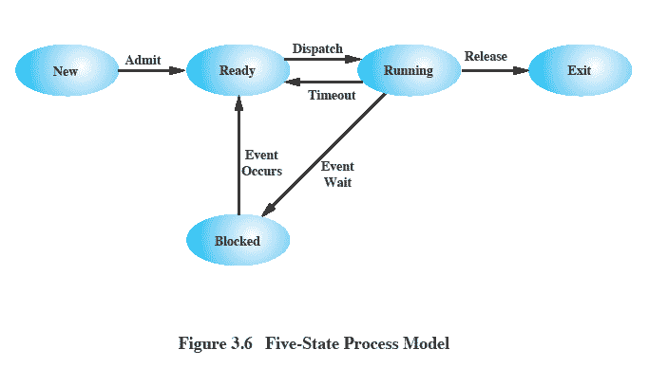
Five States Process Model

Slide 14
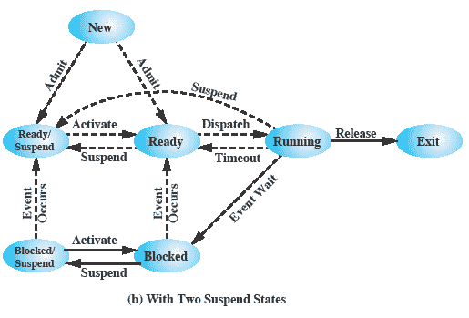
Scheduling Life Cycle

Slide 15
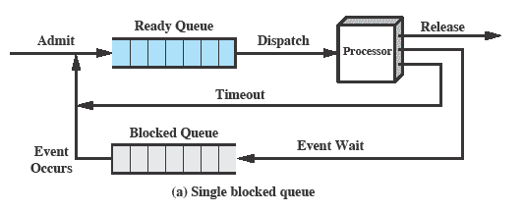
Multiple Queues

Slide 16
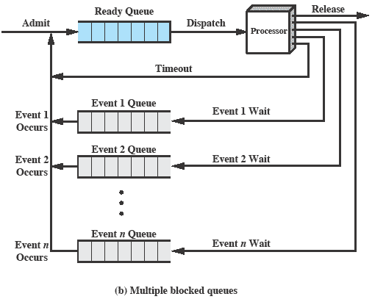
Multiple Blocked Queues

Slide 17
Suspended Processes
  Processor is faster than I/O so all processes could be waiting for I/O
    Swap these processes to disk to free up more memory and use processor on more processes
  Blocked state becomes suspend state when swapped to disk
  Two new states
    Blocked/Suspend
    Ready/Suspend

Slide 18
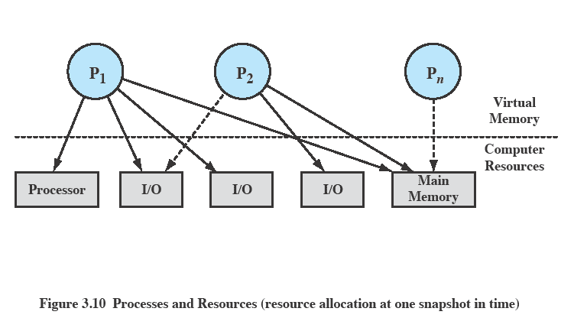
Processes and Resources

Slide 19
OS Control Structures
For the OS is to manage processes and resources, it must have information about the current status of each process and resource.
Tables are constructed for each entity the operating system manages

Slide 20
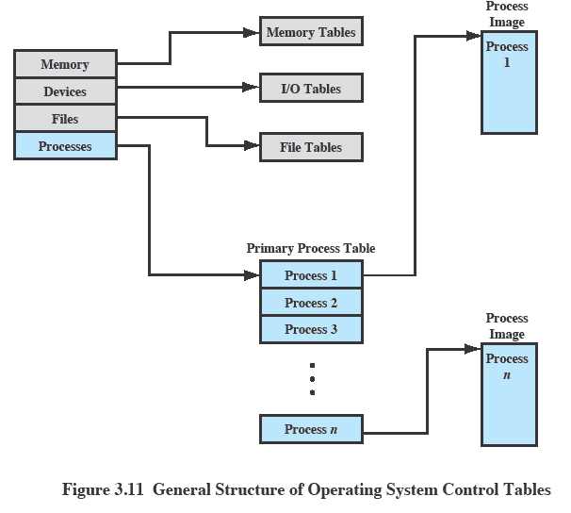
OS Control Tables

Slide 21
Memory Tables
Memory tables are used to keep track of both main and secondary memory.
Must include this information:
    Allocation of main memory to processes
    Allocation of secondary memory to processes
    Protection attributes for access to shared memory regions
    Information needed to manage virtual memory

Slide 22
IO Tables
Used by the OS to manage the I/O devices and channels of the computer.
The OS needs to know
    Whether the I/O device is available or assigned
    The status of I/O operation
    The location in main memory being used as the source or destination of the I/O transfer

Slide 23
File Tables
These tables provide information about:
  Existence of files
  Location on secondary memory
  Current Status
  other attributes.
Sometimes this information is maintained by a file management system

Slide 24
Process Tables
To manage processes the OS needs to know details of the processes
  Current state
  Process ID
  Location in memory
Process control block
  Process image is the collection of program. Data, stack, and attributes

Slide 25
Process Attributes
We can group the process control block information into three general categories:
  Process identification
  Processor state information
  Process control information

Slide 26
Process Identification
Each process is assigned a unique numeric identifier.
Many of the other tables controlled by the OS may use process identifiers to cross-reference process tables

Slide 27
Processor State Information
This consists of the contents of processor registers.
    User-visible registers
    Control and status registers
    Stack pointers
Program status word (PSW)
    contains status information
    Example: the EFLAGS register on Pentium processors

Slide 28
Process Control Block
  The most important data structure in an OS
    It defines the state of the OS
  Process Control Block requires protection
    A faulty routine could cause damage to the block destroying the OS’s ability to manage the process
    Any design change to the block could affect many modules of the OS

Slide 29
Modes of Execution
Most processors support at least two modes of execution
User mode
    Less-privileged mode
    User programs typically execute in this mode
System mode
    More-privileged mode
    Kernel of the operating system

Slide 30
Process Creation
Once the OS decides to create a new process it:
  Assigns a unique process identifier
  Allocates space for the process
  Initializes process control block
  Sets up appropriate linkages
  Creates or expand other data structures

Slide 31
Change of process states
  The steps in a process switch are:
    Save context of processor including program counter and other registers
    Update the process control block of the process that is currently in the Running state
    Move process control block to appropriate queue – ready; blocked; ready/suspend
    Select another process for execution
    Update the process control block of the process selected
    Update memory-management data structures
    Restore context of the selected process

Slide 32
Processes and Thread
Processes have two characteristics:
    Resource ownership - process includes a virtual address space to hold the process image
    Scheduling/execution - follows an execution path that may be interleaved with other processes
These two characteristics are treated independently by the operating system

Slide 33
Thread
  The unit of dispatching is referred to as a thread or lightweight process
  The unit of resource ownership is referred to as a process or task

Slide 34
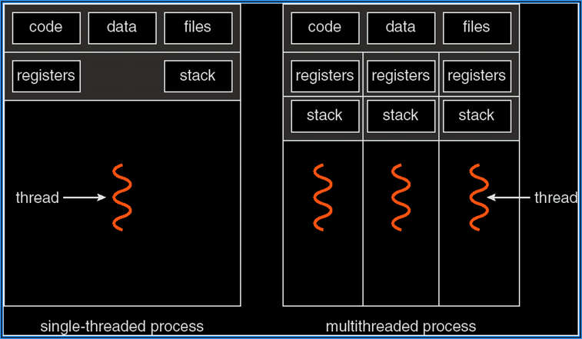
Single and Multithreaded Process

Slide 35
User and Kernel Threads
Thread management done by user-level threads library
  Three primary thread libraries: POSIX Pthreads, Win32 threads and Java threads
Kernel Threads are supported by the Kernel, Examples
  Windows XP/2000, Solaris, Linux and Mac OS X

Slide 36
Multi Threading Models
Many-to-One
One-to-One
Many-to-Many

Slide 37
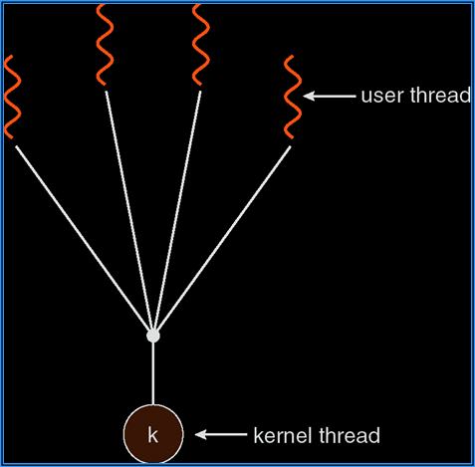
Many-to-one

Slide 38
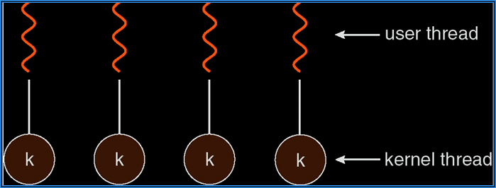
one-to-one

Slide 39
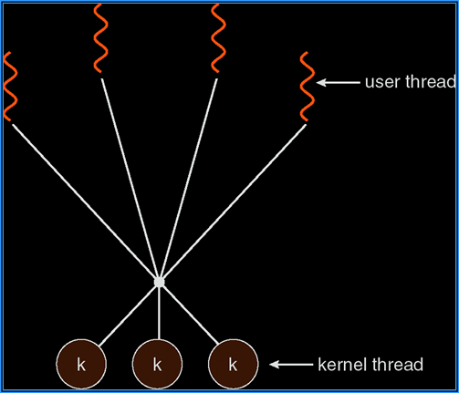
Many-to-many

Slide 40
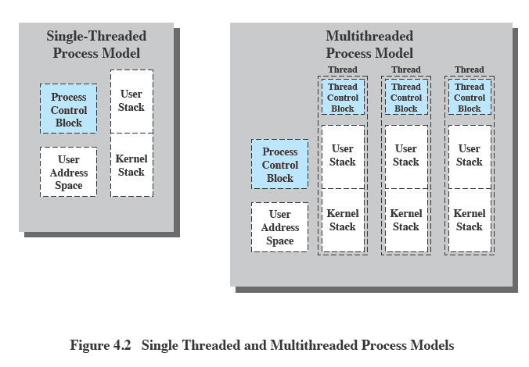
Threads vs. Processes

Slide 41
Benefits of Threads
Takes less time to create a new thread than a process
Less time to terminate a thread than a process
Switching between two threads takes less time that switching processes
Threads can communicate with each other without invoking the kernel

Slide 42
Threads
Several actions that affect all of the threads in a process
  The OS must manage these at the process level.
Examples:
  Suspending a process involves suspending all threads of the process
  Termination of a process, terminates all threads within the process

Slide 43
Java Threads
Java threads are managed by the JVM
Java threads may be created by:
    Extending Thread class
    Implementing the Runnable interface

Slide 44
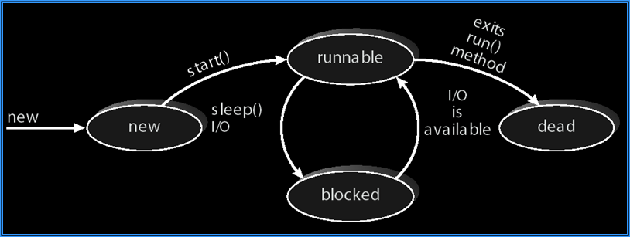
Java Thread States

Slide 45
Revision
What is Process,
Process elements,
Process control block,
Process creation and termination,
OS Control tables,
Threads

